Slide 1
Quicksort

Slide 2
Thanks
Several slides in this set are from Prof. Jim Anderson’s COMP 202 notes.

Slide 3
Performance
Worst-case execution time – Θ(n²).
Average-case execution time – Θ(n lg n).
How do the above compare with the complexities of other sorting algorithms?
Empirical and analytical studies show that quicksort can be expected to be twice as fast as its competitors.

Slide 4
Design
Follows the divide-and-conquer paradigm.
Divide: Partition (rearrange) the array A[p..r] into two (possibly empty) subarrays A[p..q–1] and A[q+1..r].
  Each element in A[p..q–1] ≤ A[q].
  A[q] ≤ each element in A[q+1..r].
  Index q is computed as part of the partitioning procedure.
Conquer: Sort the two subarrays by recursive calls to quicksort.
Combine: The subarrays are sorted in place – no work is needed to combine them.
How do the divide and combine steps of quicksort compare with those of merge sort?

Slide 5
Pseudocode
Quicksort(A, p, r)
if p < r then
q := Partition(A, p, r);
Quicksort(A, p, q – 1);
Quicksort(A, q + 1, r)
fi
Partition(A, p, r)
x, i := A[r], p – 1;
for j := p to r – 1 do
if A[j] ≤ x then
i := i + 1;
A[i] ↔ A[j]
fi
od;
A[i + 1] ↔ A[r];
return i + 1
A[p..r]
5
A[p..q – 1]
A[q+1..r]
Partition
5
≤ 5
≥ 5

Slide 6
Example
p r
initially: 2 5 8 3 9 4 1 7 10 6 note: pivot (x) = 6
i j
next iteration: 2 5 8 3 9 4 1 7 10 6
i j
next iteration: 2 5 8 3 9 4 1 7 10 6
i j
next iteration: 2 5 8 3 9 4 1 7 10 6
i j
next iteration: 2 5 3 8 9 4 1 7 10 6
i j

Slide 7
Example (Continued)
next iteration: 2 5 3 8 9 4 1 7 10 6
i j
next iteration: 2 5 3 8 9 4 1 7 10 6
i j
next iteration: 2 5 3 4 9 8 1 7 10 6
i j
next iteration: 2 5 3 4 1 8 9 7 10 6
i j
next iteration: 2 5 3 4 1 8 9 7 10 6
i j
next iteration: 2 5 3 4 1 8 9 7 10 6
i j
after final swap: 2 5 3 4 1 6 9 7 10 8
i j

Slide 8
Partitioning
Partition always selects the last element A[r] in the subarray A[p..r] as the pivot – the element around which to partition.
As the procedure executes, the array is partitioned into four (possibly empty) regions.
  A[p..i] — All entries in this region are ≤ pivot.
  A[i+1..j – 1] — All entries in this region are > pivot.
  A[r] = pivot.
  A[j..r – 1] — Not known how they compare to pivot.
  The above hold before each iteration of the for loop, and hence constitute a loop invariant. (The last condition is not needed as part of the LI.)

Slide 9
Correctness of Partition
Use loop invariant.
Initialization:
  Before first iteration
    A[p..i] and A[i+1..j – 1] are empty – Conds. 1 and 2 are satisfied (trivially).
    r is the index of the pivot – Cond. 3 is satisfied.
Maintenance:
  Case 1: A[j] > x
    Increment j only.
    LI is maintained.

Slide 10
Correctness of Partition
Case 1:
p
i
j
r
>x
x
≤ x
> x
p
i
j
r
x
≤ x
> x

Slide 11
Correctness of Partition
Case 2: A[j] ≤ x
  Increment i
  Swap A[i] and A[j]
    Condition 1 is maintained.
  Increment j
    Condition 2 is maintained.
  A[r] is unaltered.
    Condition 3 is maintained.
p
i
j
r
≤ x
x
≤ x
> x
p
i
j
r
x
≤ x
> x

Slide 12
Correctness of Partition
Termination:
  When the loop terminates, j = r, so all elements in A are partitioned into one of the three cases:
    A[p..i] ≤ pivot
    A[i+1..j – 1] > pivot
    A[r] = pivot
The last two lines swap A[i+1] and A[r].
  Pivot moves from the end of the array to between the two subarrays.
  Thus procedure partition does what is required of the divide step.

Slide 13
Complexity of Partition
Given by the number of iterations in the for loop.
Θ(n) : n = r – p + 1.

Slide 14
Algorithm Performance
Running time of quicksort depends on whether the partitioning is balanced or not.
Worst-Case Partitioning (Unbalanced Partitions):
  Occurs when every call to partition results in the most unbalanced partition.
  Partition is most unbalanced when
    Subproblem 1 is of size n – 1, and subproblem 2 is of size 0 or vice versa.
    pivot ≥ every element in A[p..r – 1] or pivot < every element in A[p..r – 1].
  Every call to partition is most unbalanced when
    Array A[1..n] is sorted or reverse sorted!

Slide 15
Worst-case Partition Analysis
Recursion tree for
worst-case partition
n
n – 1
Running time for worst-case partitions at each recursive level:
T(n) = T(n – 1) + T(0) + T(Partition)
= T(n – 1) + Θ(n)
= ∑_{k=1 to n}Θ(k)
= Θ(∑_{k=1 to n} k )
= Θ(n²)
n – 2
n
n – 3
2
1

Slide 16
Best-case Partitioning
Size of each subproblem ≤ n/2.
  One of the subproblems is of size ⎣n/2⎦
  The other is of size ⎡n/2⎤ −1.
Recurrence for running time
  T(n) ≤ 2T(n/2) + T(Partition)
  = 2T(n/2) + Θ(n)
T(n) = Θ(n lg n)

Slide 17
Recursion Tree for Best-case Partition
cn
cn
cn/2
cn/2
cn
lg n
cn/4
cn/4
cn/4
cn/4
cn
c
c
c
c
c
c
cn
Total : O(n lg n)

Slide 18
Average-Case Time Analysis
What happens if we get sort-of-balanced partitions, e.g., something like:
    T(n) ≤ T(9n/10) + T(n/10) + Θ(n)?
Still get Θ(n lg n)!! (As long as the split is of constant proportionality.)
Intuition: Can divide n by c > 1 only Θ(lg n) times before getting 1.
        n
        ↓
        n/c
        ↓
        n/c²
        ↓
        
        ↓
        1= n/c^{log}c^{n}
Refer to notes on solving
recurrences using
recursion trees.
roughly, log_{c} n steps.
Cost at each level is at most n.
Intuition holds even if c is very close to 1, e.g., 100/99.
(Remember: Different base logs are related by a constant.)

Slide 19
Intuition for the Average Case
Partitioning is unlikely to happen in the same way at every level.
  Split ratio is likely to be different for different levels. (Contrary to our assumption in the previous slide.)
Partition produces a mix of “good” and “bad” splits, distributed randomly in the recursion tree.
What is the running time likely to be in such a case?

Slide 20
Intuition for the Average Case
n
Bad split followed by a good split:
Produces subarrays of sizes 0, (n – 1)/2 – 1, and (n – 1)/2.
Cost of partitioning :
Θ(n) + Θ(n-1) = Θ(n).
Θ(n)
0
n – 1
(n – 1)/2 – 1
(n – 1)/2
Good split at the first level:
Produces two subarrays of size (n – 1)/2.
Cost of partitioning :
Θ(n).
n
Θ(n)
(n – 1)/2
(n – 1)/2
Situation at the end of case 1 is not worse than that at the end of case 2.
When splits alternate between good and bad, the cost of bad split can be absorbed into the cost of good split.
Thus, running time is O(n lg n), though with larger hidden constants.

Slide 21
Randomized Version
Want to make running time independent of input ordering.
How can we do that?
  Make the algorithm randomized.
  Make every possible input equally likely.
    Can randomly permute the entire array, as we did for the hiring problem.
    For quicksort, it is sufficient if we can ensure that every element is equally likely to be the pivot.
    Therefore, we choose an element in A[p..r] and exchange it with A[r].
    Because the pivot is randomly chosen, we expect the partitioning to be well balanced on average.

Slide 22
Randomized Version
Want to make running time independent of input ordering.
Randomized-Partition(A, p, r)
i := Random(p, r);
A[r] ↔ A[i];
Partition(A, p, r)
Randomized-Quicksort(A, p, r)
if p < r then
q := Randomized-Partition(A, p, r);
Randomized-Quicksort(A, p, q – 1);
Randomized-Quicksort(A, q + 1, r)
fi

Slide 23
Worst-case Analysis
Applies to both QuickSort and Randomized Quicksort.
Running time with worst-case split at every level was shown to be Θ(n²).
Will prove that this is the worst-case complexity.
Recurrence for the worst-case running time is:
  T(n) = max (T(q) + T(n – q – 1)) + Θ(n)
^{0 ≤ q ≤ n-1}
  q ranges between 0 and n – 1, because Partition produces two subproblems with total size n – 1.
Guess T(n) ≤ cn², for some constant c.
Substitute the guess into the above recurrence.

Slide 24
Worst-case Analysis
Substituting,
  T(n) ≤ max (cq² + c(n – q – 1)²) + Θ(n)
^{0≤ q≤ n-1}
  = c. max (q² + (n – q – 1)²) + Θ(n)
^{0≤ q≤ n-1}
The maximum value of q² + (n – q – 1)² occurs when q is either 0 or n – 1.
  q = (n – 1)/2 is either a local maximum or minimum point.
    (Solve for q by setting first derivative w.r.t. q to 0.)
  Second derivative w.r.t. q is positive.
    So, q = (n – 1)/2 is a minimum point.
So, max (q² + (n – q – 1)²) ≤ (n – 1)²
^{0≤ q≤ n-1} = n² – 2n + 1.

Slide 25
Worst-case Analysis
Therefore,
  T(n) ≤ cn² – c(2n – 1) + Θ(n)
  ≤ cn² if c(2n – 1) ≥ Θ(n)
Pick c so that c(2n – 1) dominates Θ(n).
So, worst-case running time is O(n²).
Can also show that the solution of the recurrence is Ω(n²).
Thus, worst-case running time is Θ(n²).

Slide 26
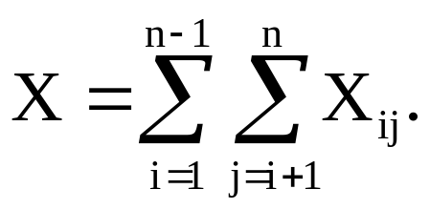
Avg. Case Analysis of Randomized Quicksort
Let RV X = number of comparisons over all calls to Partition.
Suffices to compute E[X]. Why?
Notation:
  Let z₁, z₂, …, z_{n} denote the list items (in sorted order).
  Let Z_{ij} = {z_{i}, z_{i+1}, …, z_{j}}.
Let RV X_{ij} =
Thus,
1 if z_{i} is compared to z_{j}
0 othewise
X_{ij} is an
indicator random variable.
X_{ij}=I{z_{i} is compared to z_{j}}.

Slide 27
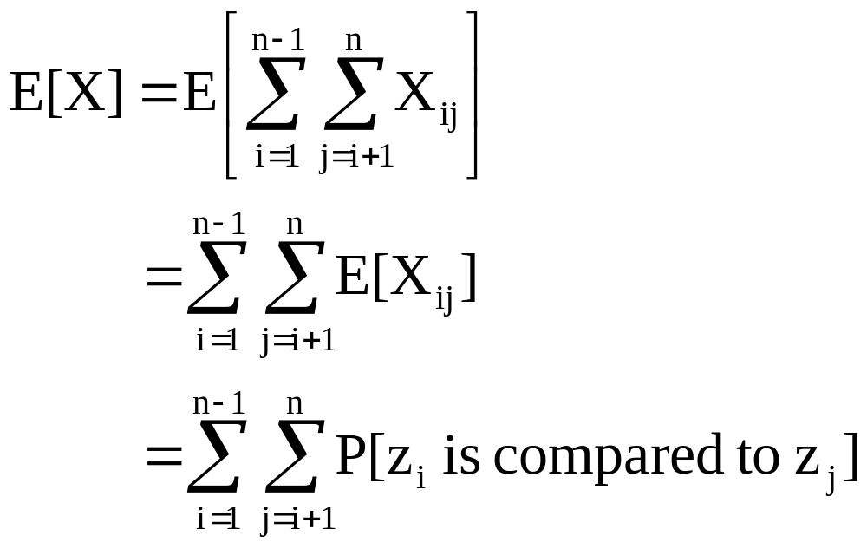
Analysis (Continued)
We have:
Note:
E[X_{ij}] = 0·P[X_{ij}=0] + 1·P[X_{ij}=1]
= P[X_{ij}=1]
This is a nice property of
indicator RVs. (Refer to notes on Probabilistic Analysis.)
So, all we need to do is to compute P[z_{i} is compared to z_{j}].

Slide 28
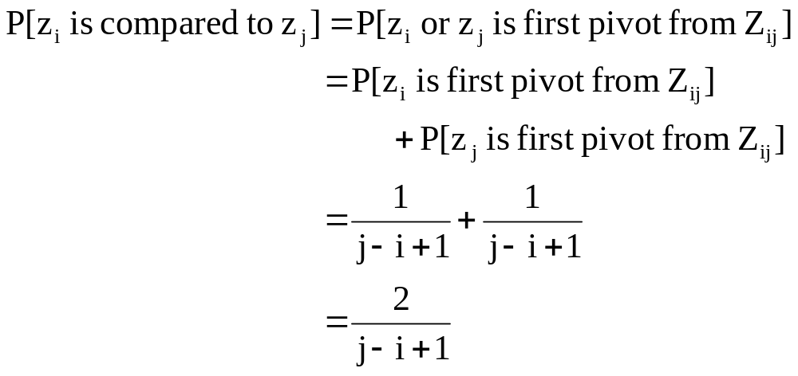
Analysis (Continued)
z_{i} and z_{j} are compared iff the first element to be chosen as a pivot
from Z_{ij} is either z_{i} or z_{j}.
Exercise: Prove this.
So,

Slide 29
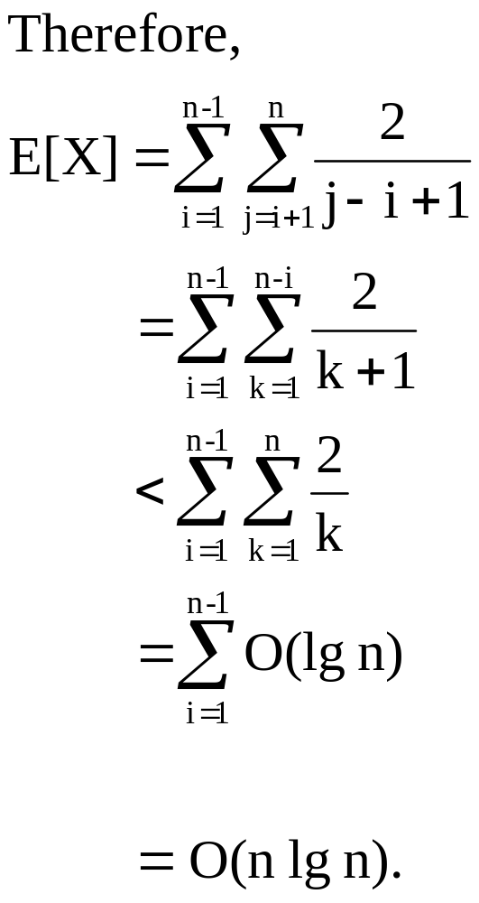
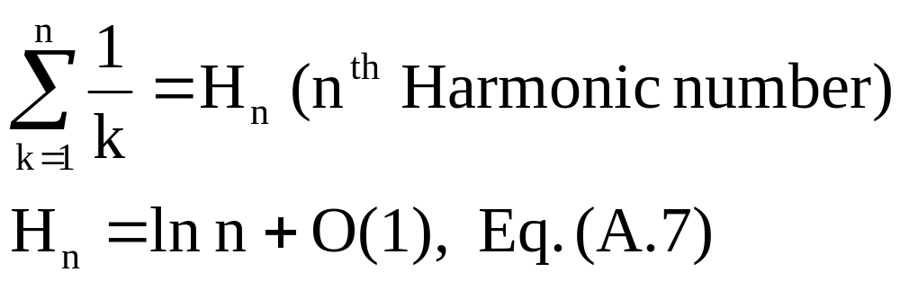
Analysis (Continued)
Substitute k = j – i.

Slide 30
Stack Space
Algorithm as shown sorts sub-problems in a fixed order. This can lead to deep O(n) call stacks.
Fix: Stack larger sub-problem, solve smaller sub-problem first.
  Stack space becomes O(lg n).
  Recurrence is:
    S(n) = 0, n ≤ 2.
    S(n) = 1 + S(⎣(n–1)/2⎦), n > 2.

Slide 31
Variations
Quicksort is not very efficient on small lists.
This is a problem because Quicksort will be called on lots of small lists.
Fix 1: Use Insertion Sort on small problems.
Fix 2: Leave small problems unsorted. Fix with one final Insertion Sort at end.
  Note: Insertion Sort is very fast on almost-sorted lists.

Slide 32
Variations (Continued)
Input distribution may not be uniformly random.
Fix 1: Use “randomly” selected pivot.
  We’ve already analyzed this for a slightly different algorithm.
Fix 2: Median-of-three Quicksort.
  Use median of three fixed elements (say, the first, middle, and last) as the pivot.
  To get O(n²) behavior, we must continually get unlucky and see that two out of the three elements examined are among the largest or smallest.

